Slide 1
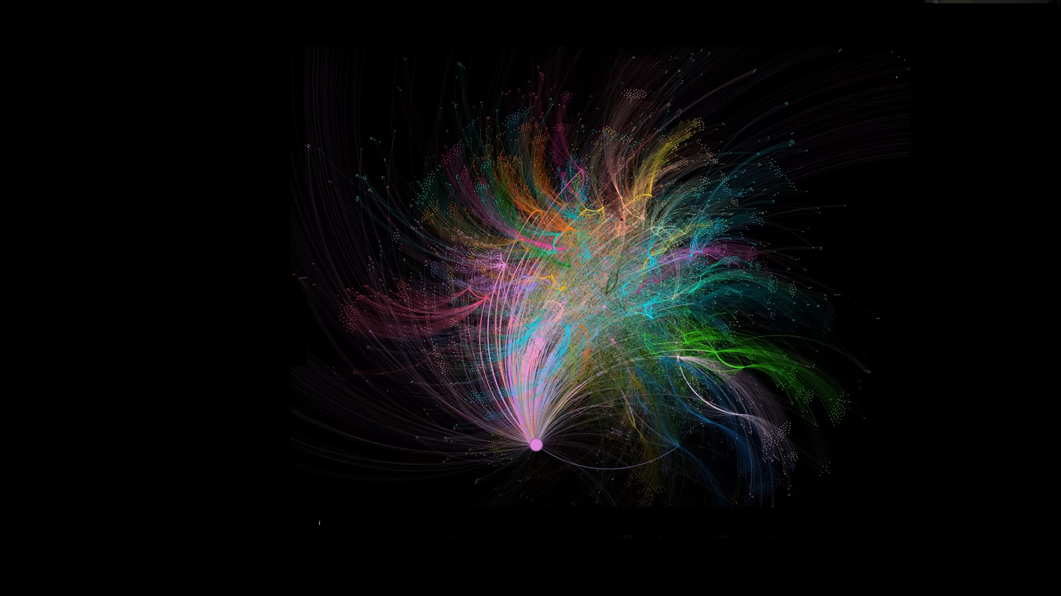
GRAPH -based Retrieval-Augmented Generation (GRAG)
LLM Memory Representation
source: Microsof\graphrag

Slide 2
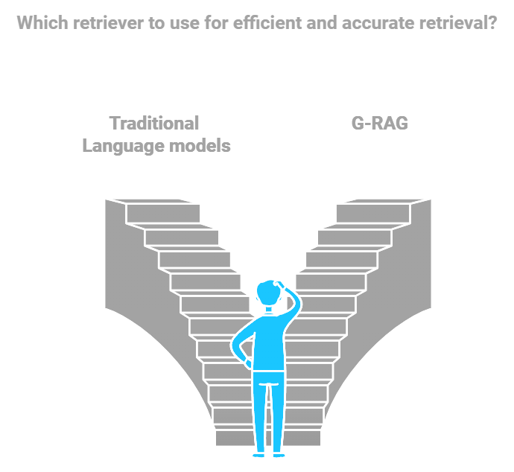
OUTLINE
Introduction
Evolution of G-RAG
Overview of G-Retriever
Overview of GRAG
Casestudy
Comparative Analysis
Future Direction
Conclusion

Slide 3
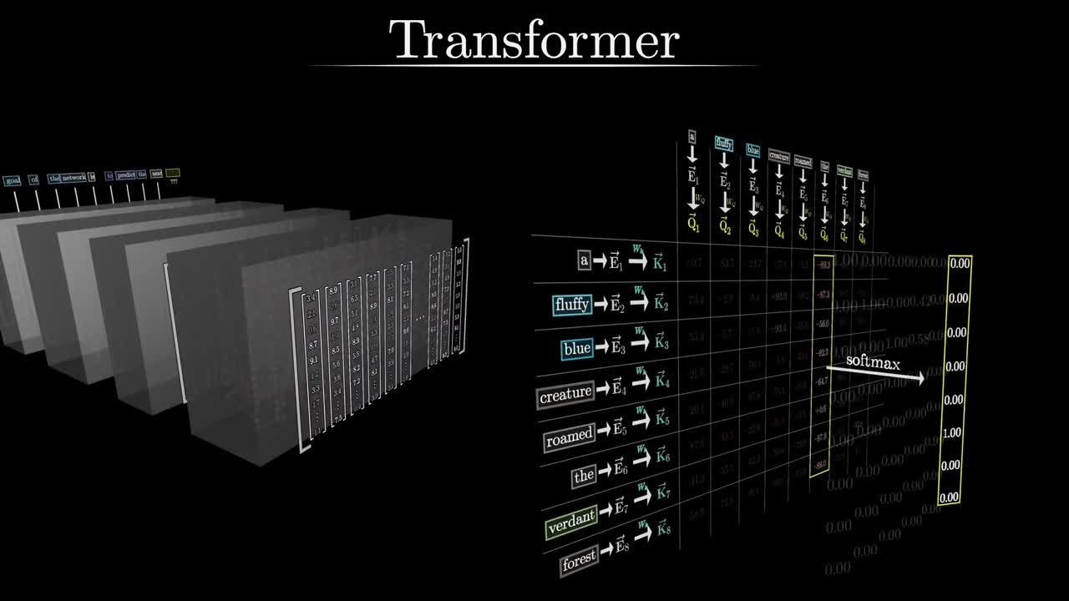
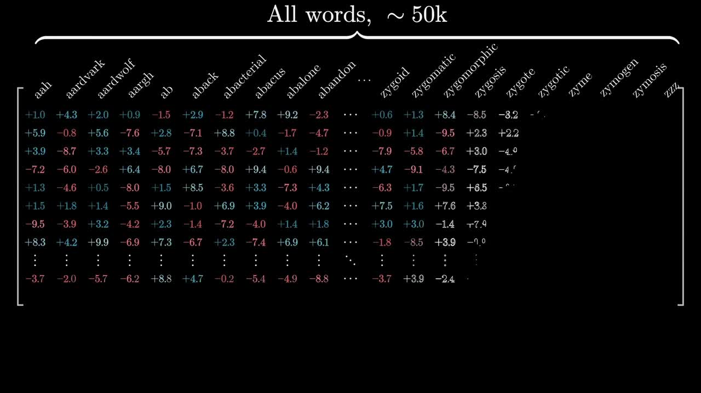
Foundation Model
INTRODUCTION
Prerequisites for Graph-Based RAG
Natural Language Processing (NLP) and LLM
Language Models : Transforms (BERT & GPT)
Embeddings : Word2vec, GloVe
Graph Theory Fundamentals
Graph Basic and traversal Algorithms
Graph Embedding : node2vec
Knowledge Graph and Graph Databases
Knowledge Representation
Graph Databases (Neo4j)
source: 3 Blue 1 brown

Slide 4
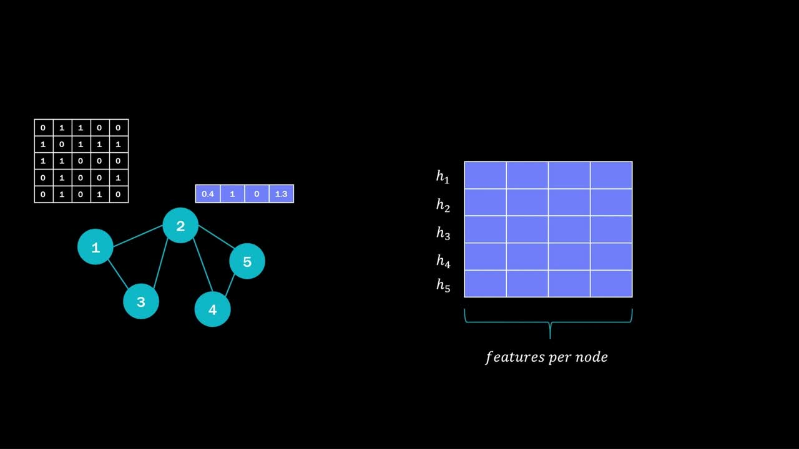
Information Retrieval (IR) Essentials
Vector Similarity : Cosine
Retrieval Methods : TF-IDF
Graph Neural Networks (GNNs)
Message Passing and Aggreation
Graph Representaion and Learning
Integrating Graphs with Language Models
Hybrid Models : Graph + LLM
Multi-Modal Training
source: Internet

Slide 5
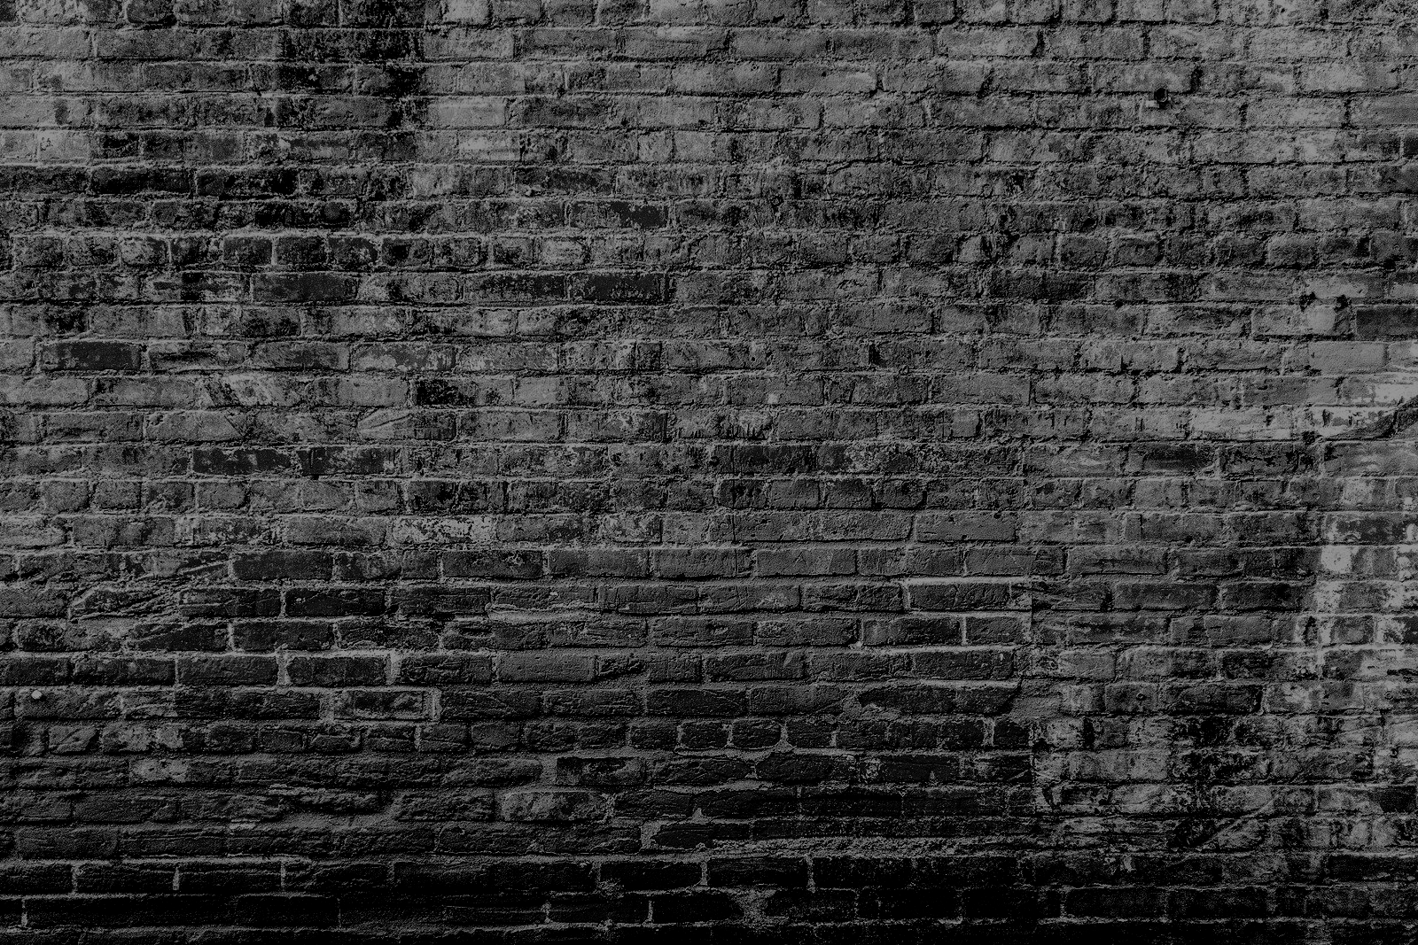
The Evolution of Graph-Based Retrieval-Augmented Generation
Knowledge Representation and Graph Theory
(1970s-1990s)
Rise of Deep Learning and Neural Network
(2010s)
Advancements in Hybrid Models
(2020s)
1
3
5
7
2
4
6
Foundation of Information Retrieval
(1960s-1980s)
Advent of Machine Learning in IR
(1990s-2000s)
Introduction of Retrieval-Augmented Generation
(2019)
Emerging Applications and Challenges
(present -)

Slide 6
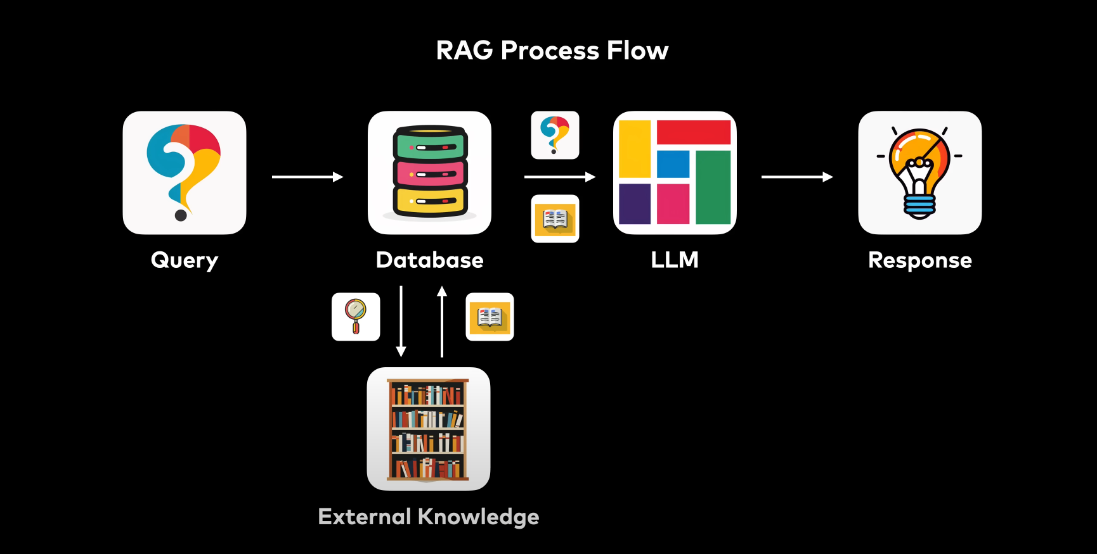
RAG
Query Translation
Routing
Query Construction
Indexing
Retrieval
Generation
source: Internet

Slide 7
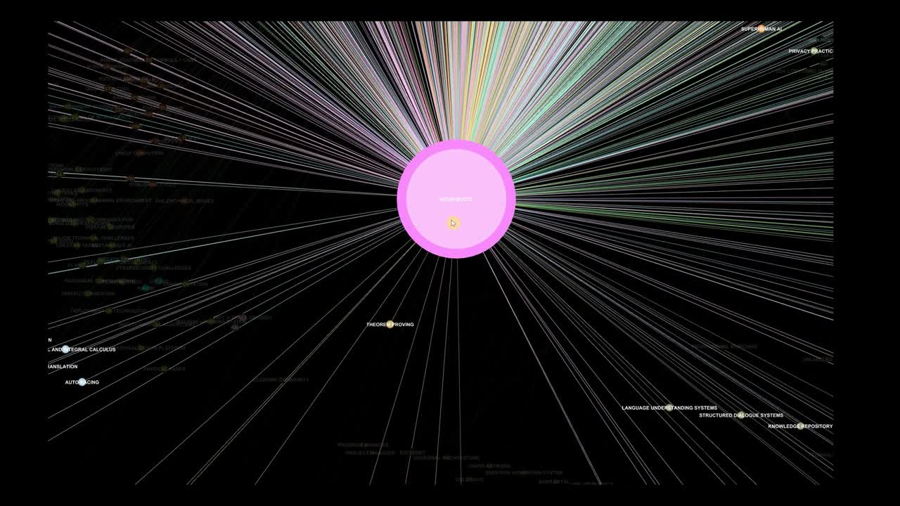
Graph based RAG
source: Microsof\graphrag
GRAG = Knowledge Graph + RAG
Do vector Search for initial set nodes.
Travel the graph around the node to add context
Top K doc send to LLM

Slide 8
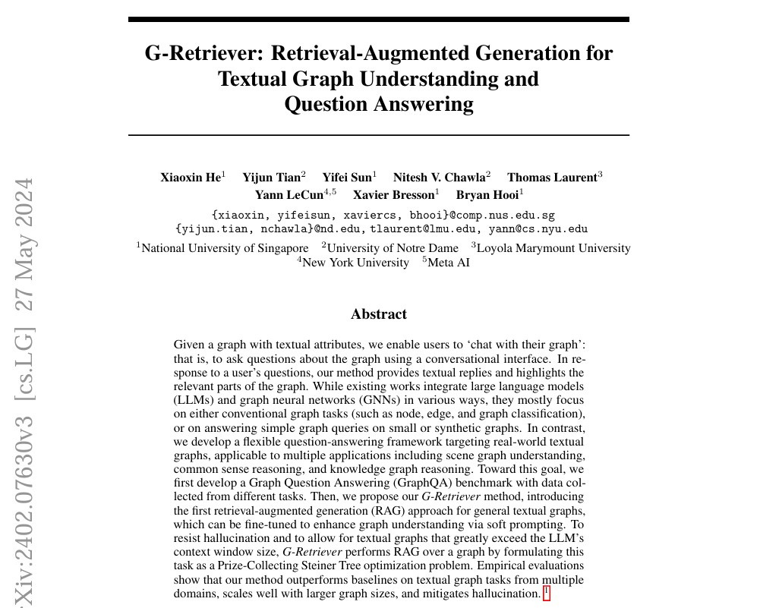
OVERVIEW OF PAPER 1
Title:- “G-Retriever: Retrieval-Agumented Generation for Textual Graph Understanding and Question Answering”
Authors:- Xiaoxin He, Yijun Tian, Yifei Sun, Nitesh V.Chawla, Thomas Laurent, Yann LeCun, Xavier Bresson, Bryan Hooi
Motivation:-
Traditional method focus on simpilar tasks like conectivity, shortest dist. etc. Real word complex questions are asked.
Scalability (too many tokens).
Reducing hallucinations in LLMs for graph data.
source:G-Retriver X.He

Slide 9
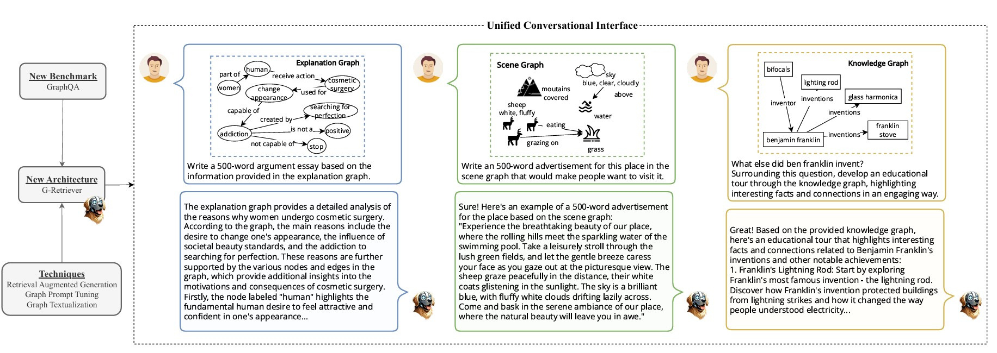
Key Innovations:
Unified Graph Quesiong-Answering Framework
3.Hallucination Mitigation
4.Scalability
2.GraphQA Benchmark
source:G-Retriver X.He

Slide 10
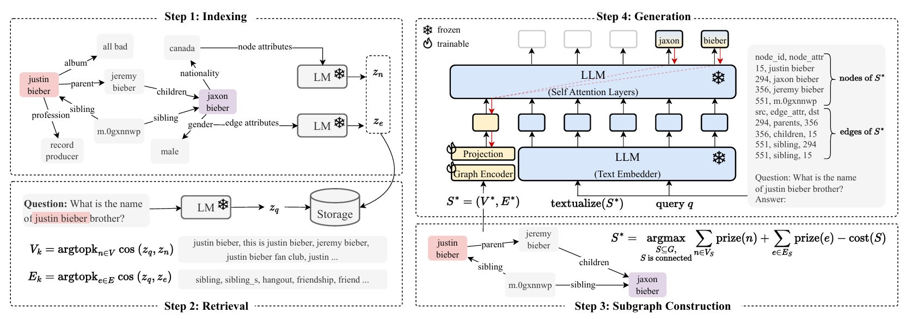
Key Steps
Indexing : Embedding nodes and edges
2. Retrieval : Selecting relevent nodes and edges for the query.
source:G-Retriver X.He

Slide 11
3. Subgraph Construction: Using PCST to build a subgraph
4. Generation: Generating an answer based on the subgraph.
source:G-Retriver X.He

Slide 12
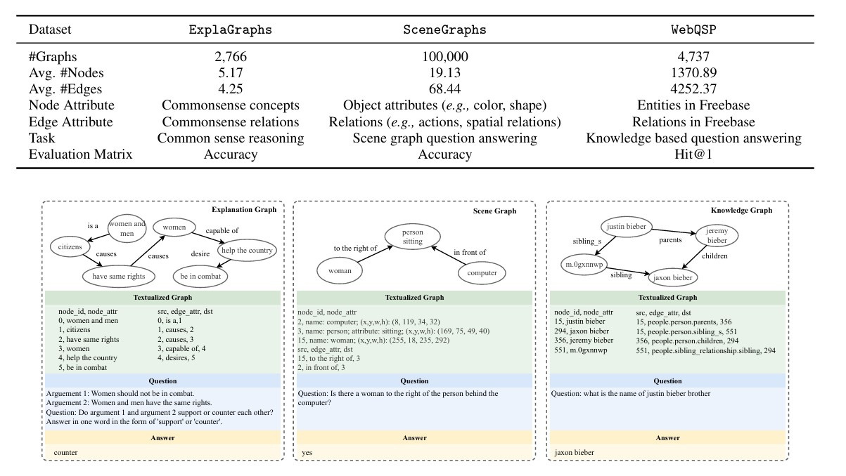
Results:
Efficiency Gains
Performance Comparson
Hallucination Reduction
source:G-Retriver X.He

Slide 13
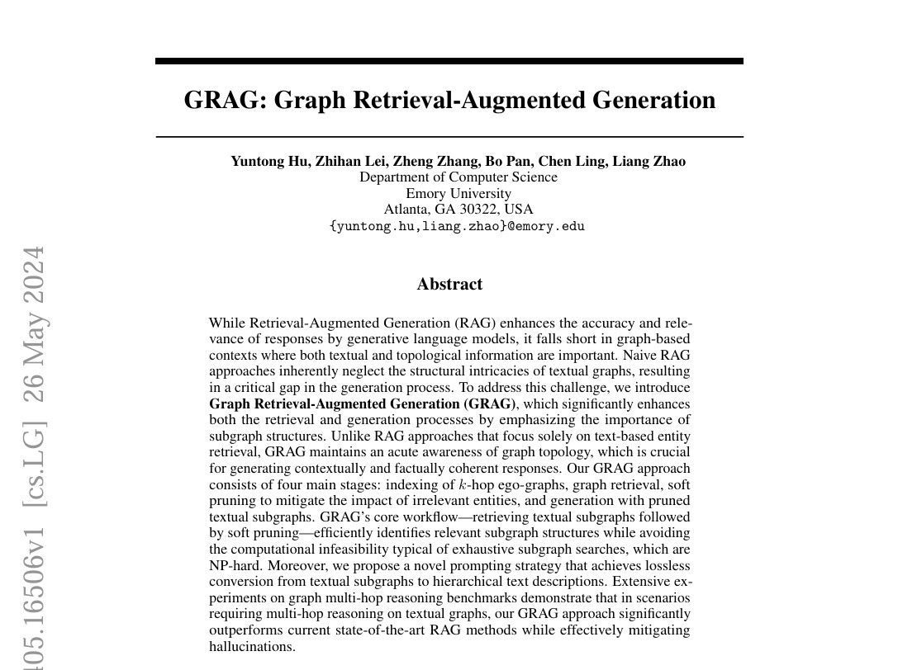
OVERVIEW OF PAPER 2
Title:- “Graph Retrieval-Augmented Generation (GRAG)”
Authors:- Yuntong Hu, Zhihan Lei, Zheng Zhang, Bo Pan, Chen Ling, Liag Zhao
Motivation:-
Traditional RAG fails using graph-based data.
Need to incorporate both textual content and graph topology in retrieval for better results.
Subgraph construction (NP Hard).
source: GRAG Y.Hu

Slide 14
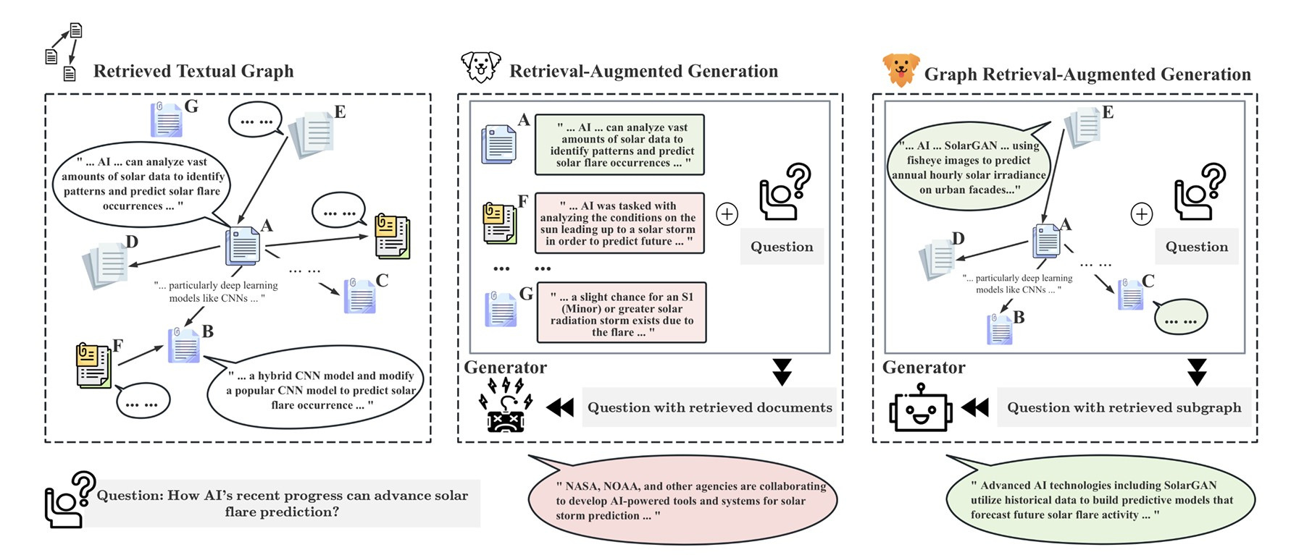
Limitations of RAG and Need of GRAG
source: GRAG Y.Hu

Slide 15
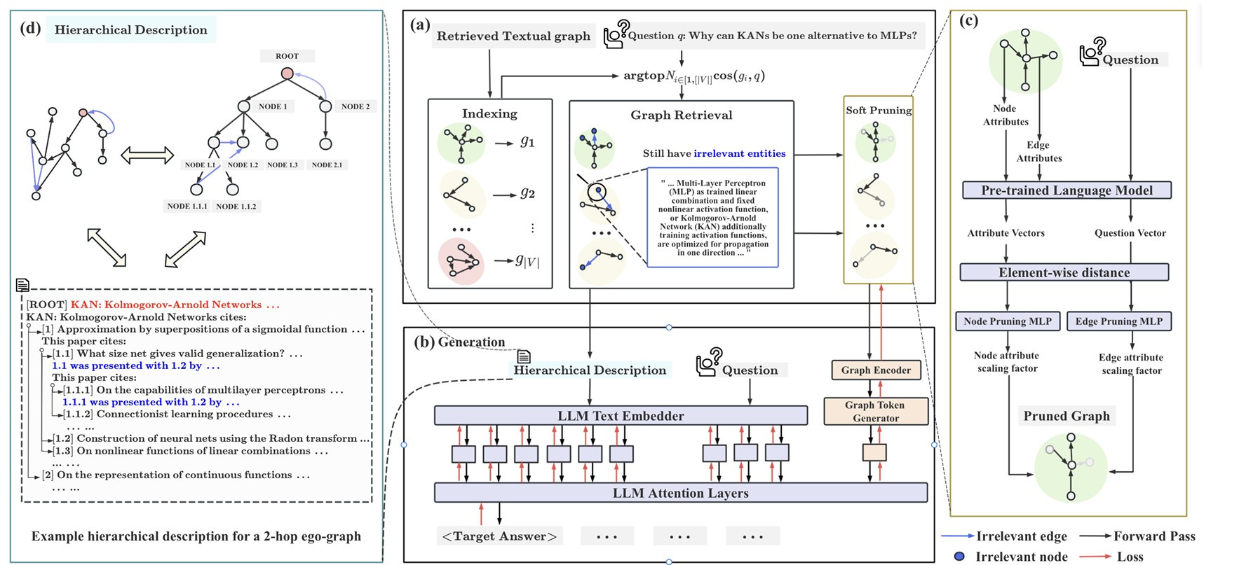
GRAG Framework
KEY Stages:
Indexing k-hop Ego-graphs: Divides large graphs into smaller subgraphs.
Graph Retrievel: Finds top-matching subgraphs based on query similarity.
source: GRAG Y.Hu

Slide 16
3.Soft Pruning:
Filters our irrelevant
nodes/edges to reduce noice.
4. Dual Prompting for Generation:
Combining Textual Prompts (hard)
with graph embedding (soft prompt)
source: GRAG Y.Hu

Slide 17
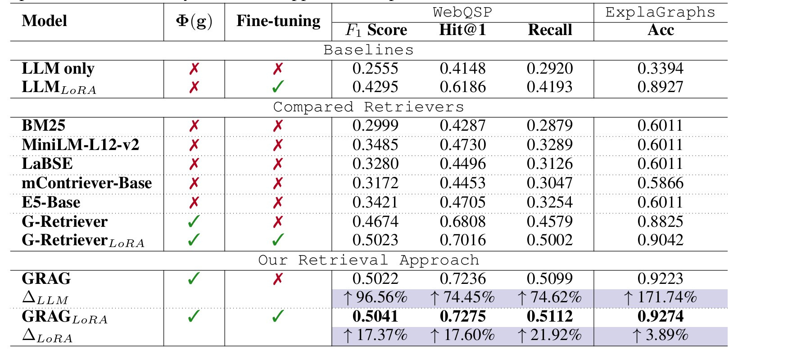
Results:-
Performance :- GRAG outperformed traditional RAG and LLM in multi hop reasoning and accuracy
Efficiency:- High accuracy with low computational cost than fine-tuned LLMs.
Hallucination Reduction:- Reduction of irrelavant data. Ground responses in actual graph data.
source: GRAG Y.Hu

Slide 18
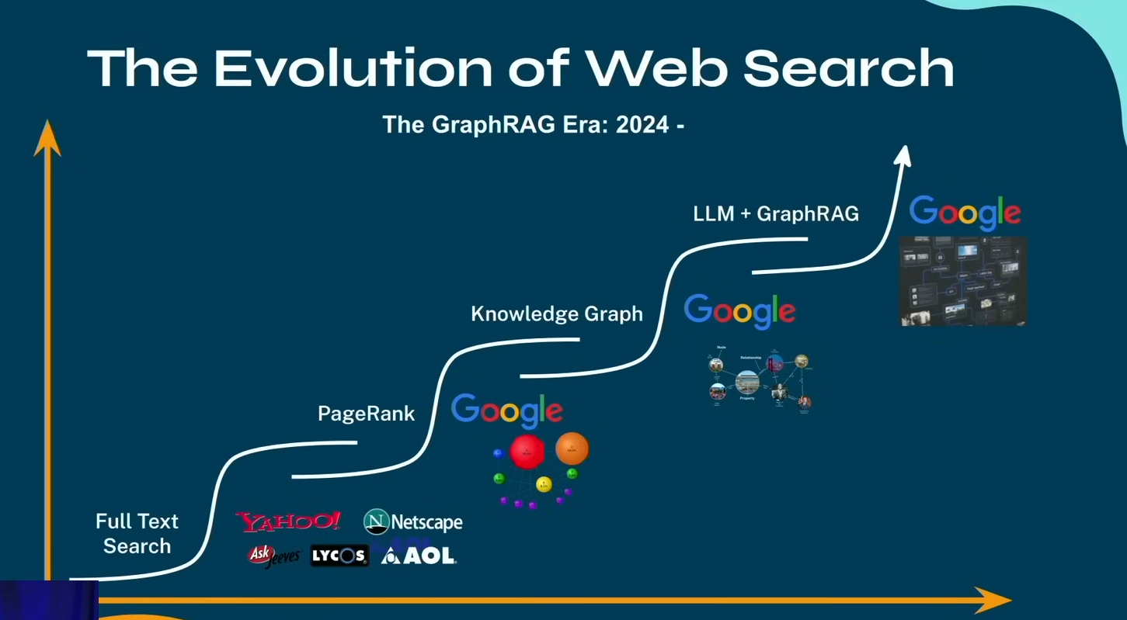
CASE STUDY

Slide 19
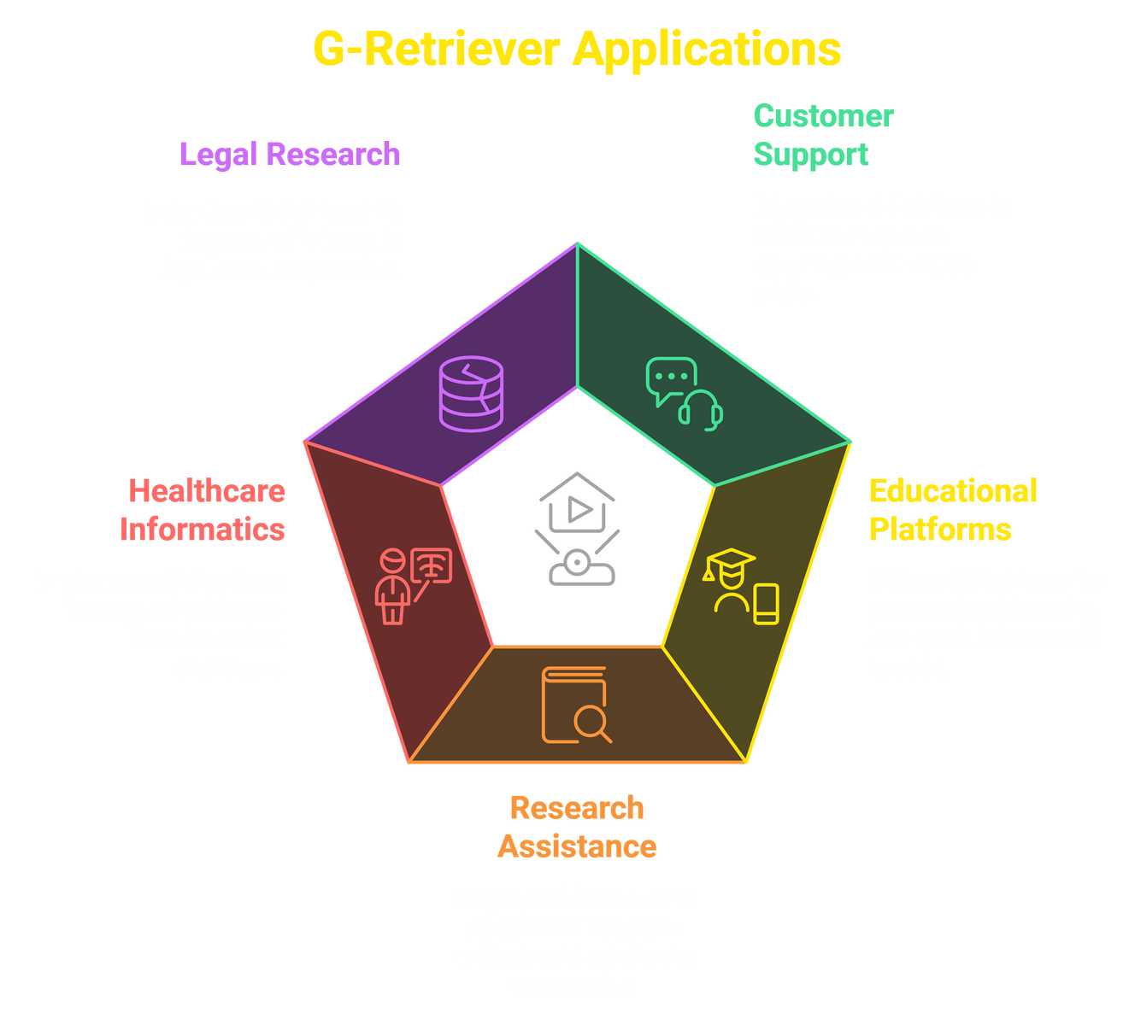
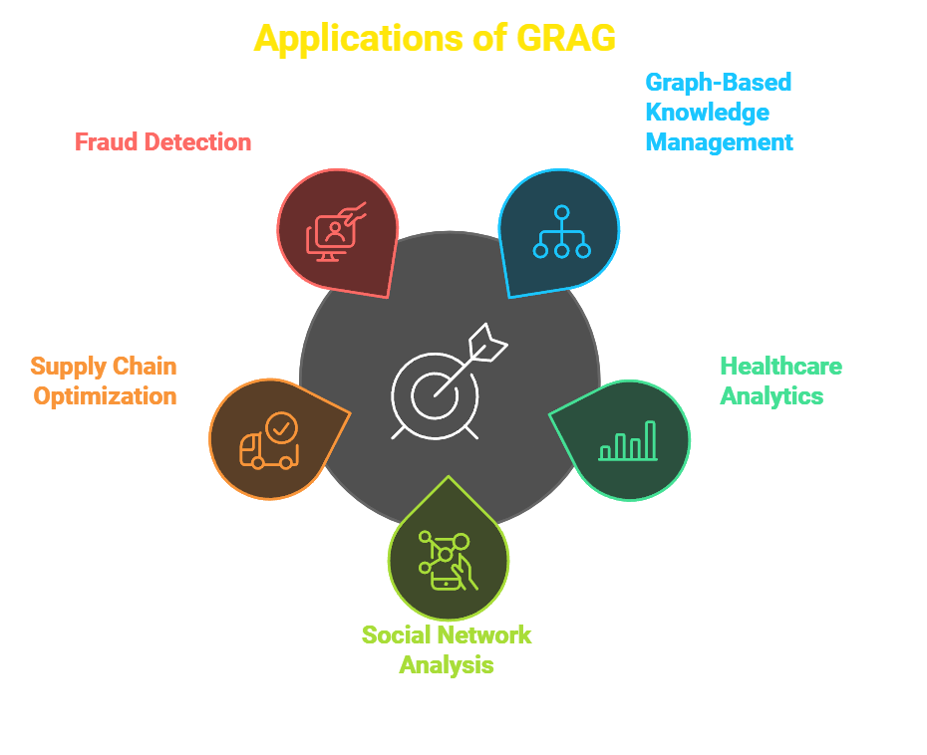
APPLICATIONS

Slide 20
COMPARATIVE ANALYSIS
Feature | G-Retriver | GRAG
Focus | Efficient retrieval with minimal hallucination | Graph topology preservation and complex reasoning
Key Techniques | Prize-Collection Steiner Tree | k-hop ego-graphs, soft puning, dual promption
Efficiency vs Fidelity | Emphasis on efficiencty, Scalability | Balance fidelity with structural retention
Advantages | -Scalability -Hallucination Resistance | -Precision in Multi-Hop Reasoning -Efficient Pruning
Limitations | -Depandancy on Graph Size -Adaptability for Deep Reasoning | -Complexity of Dual Prompting -Resource intensity in Large Graphs

Slide 21
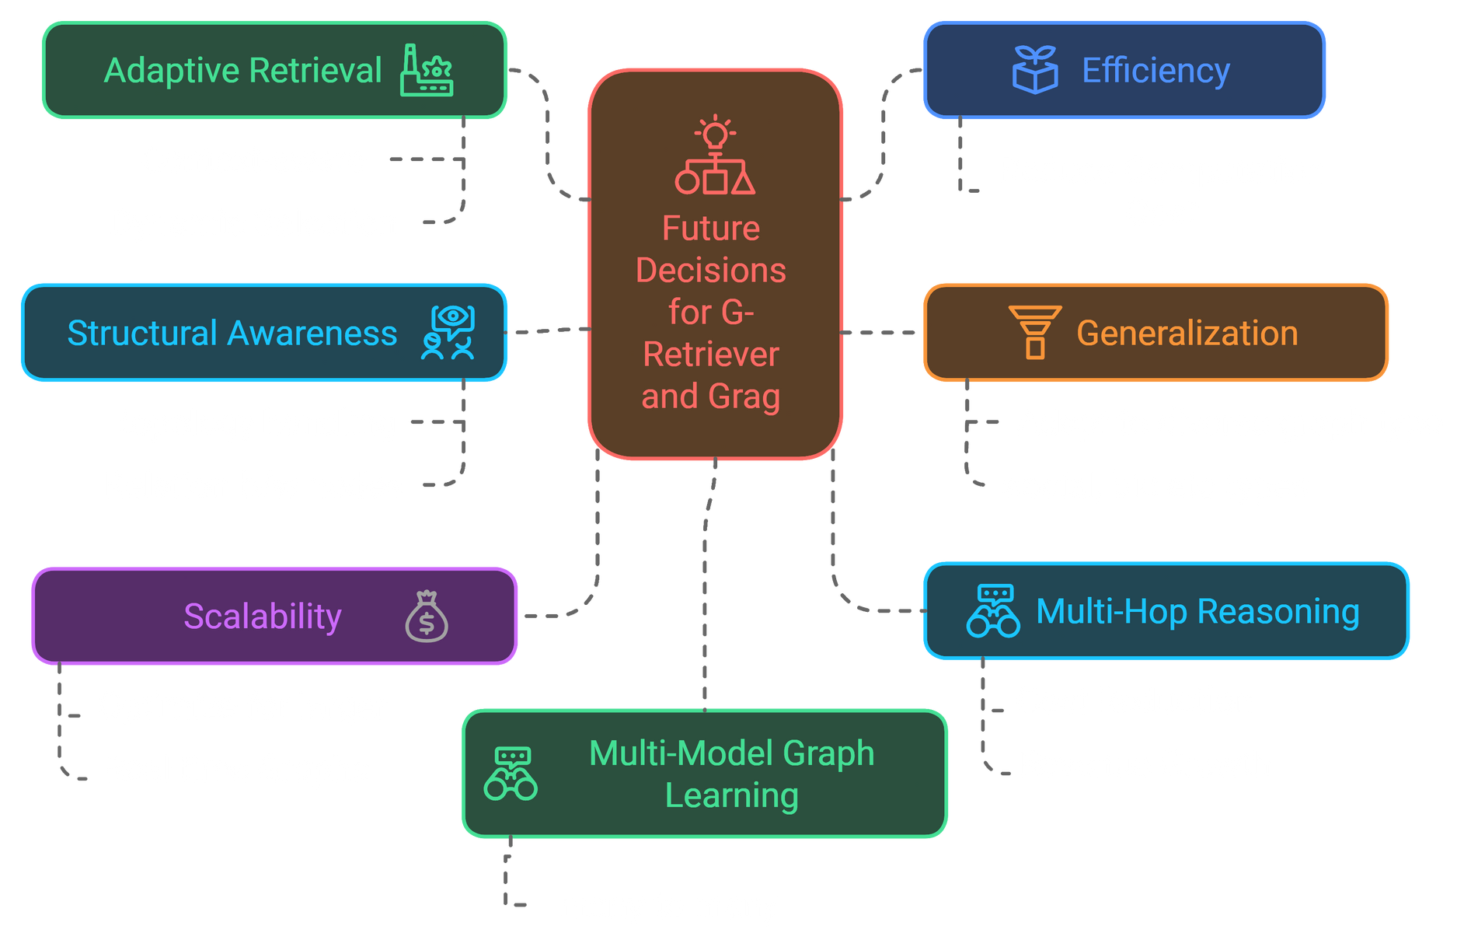
Future Direction

Slide 22
CONCLUSION
G-Rerivever : Best for fast, scalable retrieval on simple graphs
GRAG : Suited for complex reasoning and multi-hop tasks.
Application Fit: G-Retriver for efficiency; GRAG for depth.
Limitations : G-Retriever lacks deep structure; GRAG is resource-heavy
Future Potential : Adaptive retrieval for G-Retriever; efficiency for GRAG

Slide 23
REFERENCES
He, X., Tian, Y., Sun, Y., Chawla, N. V., Laurent, T., LeCun, Y., & Bresson, X. (2024). G-Retriever: Retrieval-Augmented Generation for Textual Graph Understanding and Question Answering. arXiv preprint arXiv:2402.07630v3. Retrieved from https://arxiv.org/abs/2402.07630
Hu, Y., Lei, Z., Zhang, Z., Pan, B., Ling, C., & Zhao, L. (n.d.). GRAG: Graph Retrieval-Augmented Generation. Department of Computer Science, Emory University, Atlanta, GA 30322, USA. Retrieved from [link]

Slide 24



THANK YOU

